Slide 1
CSE 519: Data Science
Steven Skiena
Stony Brook University
Lecture 1: Introduction to Data Science

Slide 2
What is Data Science?
Like any emerging field, it isn’t yet well defined, but incorporates elements of:
Exploratory Data Analysis and Visualization
Machine Learning and Statistics
High-Performance Computing technologies for dealing with scale.

Slide 3
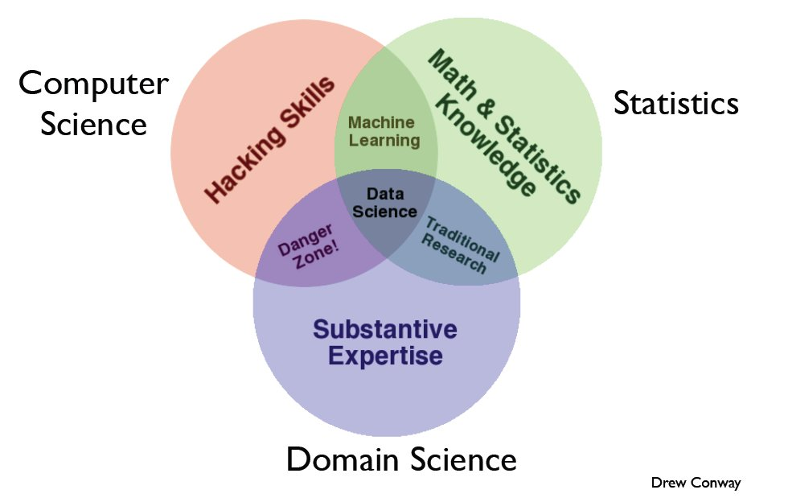
Skill Sets for Data Science

Slide 4
Appreciating Data
Computer Scientists do not naturally appreciate data: it’s just stuff to run through a program.
The usual way to test algorithm performance is to run the implementation on “random data”.
But interesting data sets are a scarce resource, which requires hard work and imagination to obtain.

Slide 5
Computer vs. Real Scientists (1)
Scientists strive to understand the complicated and messy natural world, while computer scientists build their own clean and organized virtual worlds. Thus:
Nothing is ever completely true or false in science, while everything is either true or false in Computer Science / Mathematics.

Slide 6
Computer vs. Real Scientists (2)
Scientists are data-driven, while computer scientists are algorithm-driven.
Scientists obsess about discovering things, which computer scientists invent rather than discover.
Scientists are comfortable with the idea that data has errors; computer scientists are not.

Slide 7
Genius vs. Wisdom
Software developers are hired to produce code.
Data Scientists are hired to produce insights.
Genius shows in finding the right answer!!!
Wisdom shows in avoiding the wrong answers.
Data science (like most things) benefits more from wisdom than from genius.

Slide 8
Developing Wisdom
Wisdom comes from experience.
Wisdom comes from general knowledge.
Wisdom comes from listening to others.
Wisdom comes from humility, observing how often you have been wrong and why/how.
I seek pass on wisdom, through my experience on the difficulty of making good predictions.

Slide 9
Developing Curiosity
The good data scientist develops a curiosity about the domain/application they are working in.
They talk shop with the people whose data they are working on.
They read the newspaper every day, to get a broader perspective on the world.

Slide 10
Asking Good Questions
Software developers are not encouraged to ask questions, but data scientists are:
What exciting things might you be able to learn from a given data set?
What things do you/your people really want to know?
What data sets might get you there?

Slide 11
Let’s Practice Asking Questions!
Who, What, Where, When, and Why on the following datasets:
Baseball-reference.com
International Movie Database (IMBb)
Google ngrams
NYC taxi cab records

Slide 12
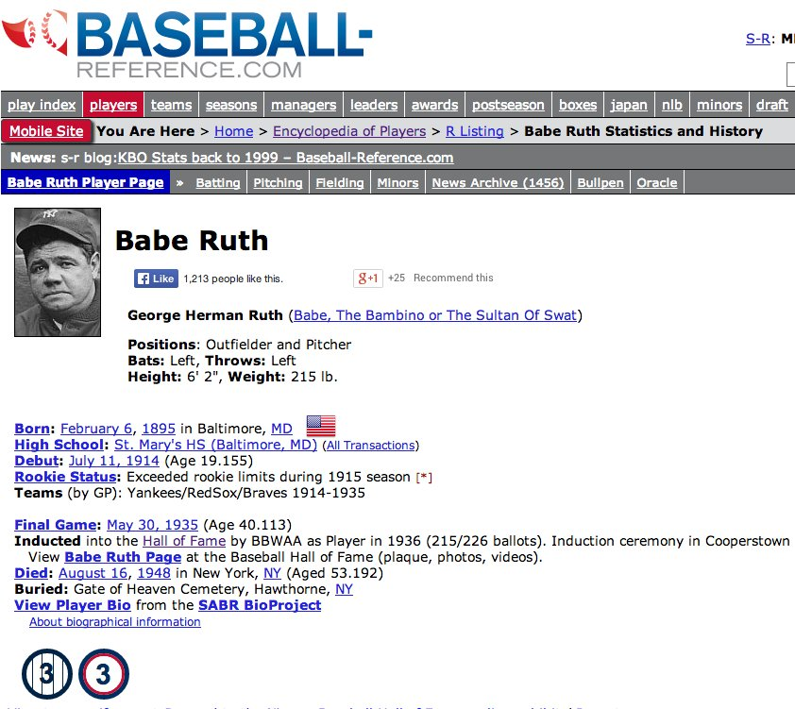
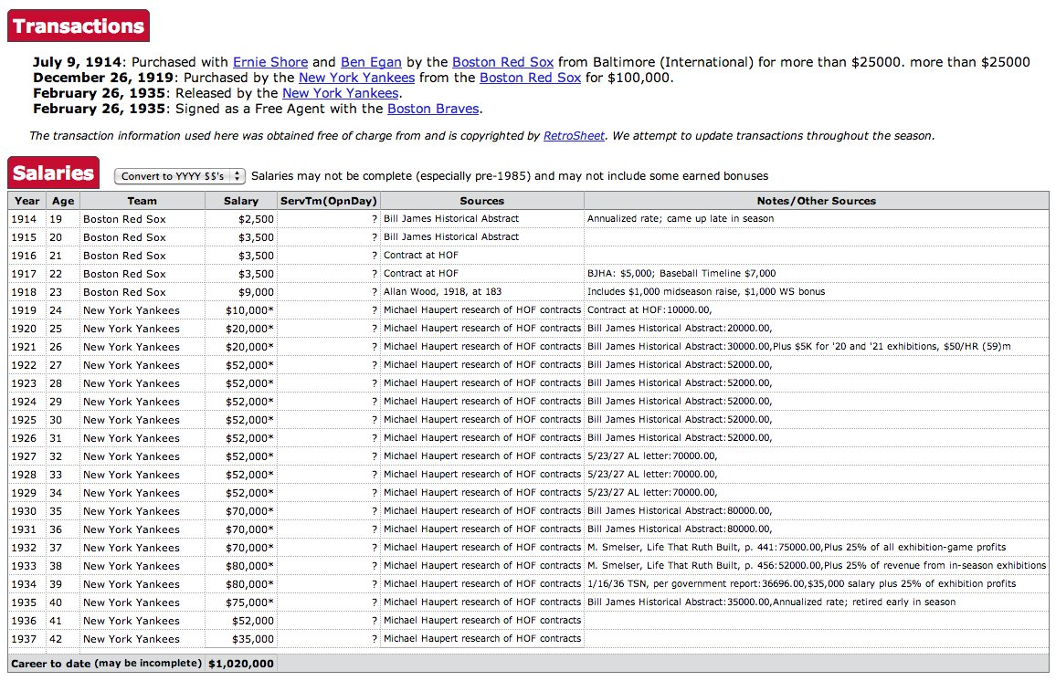
Baseball-Reference.com: biosketch

Slide 13
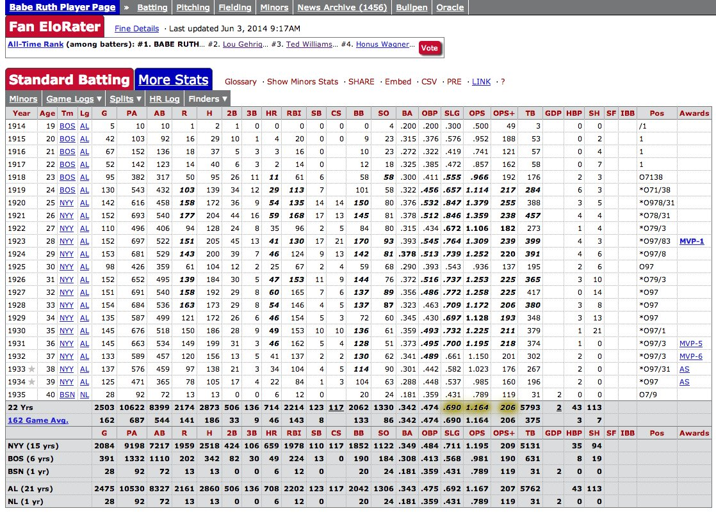
Statistical Record of Play
Summary statistics of each years batting, pitching, and fielding record, with teams and awards.

Slide 14
Baseball Questions
How to best measure individual player’s skill, value or performance?
How fair do trades between teams work out?
What is the trajectory of player’s performances as they mature and age?
To what extent does batting performance correlate with the position played?

Slide 15
Demographic Questions
Do left-handed people have shorter lifespans than right-handers?
How often do people return to where they were born?
Do player salaries reflect past, present, or future performance?
Are heights and weights increasing in the population?

Slide 16
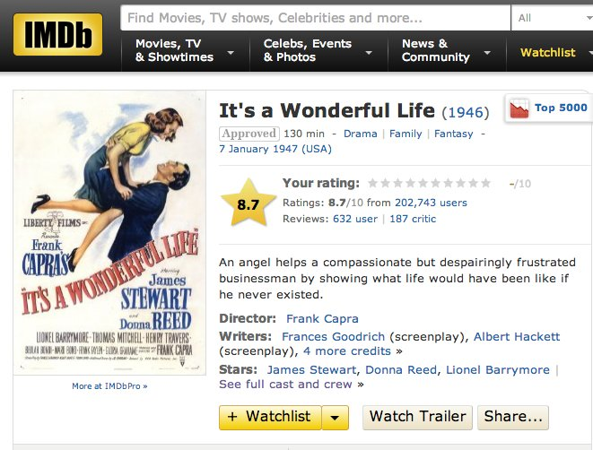
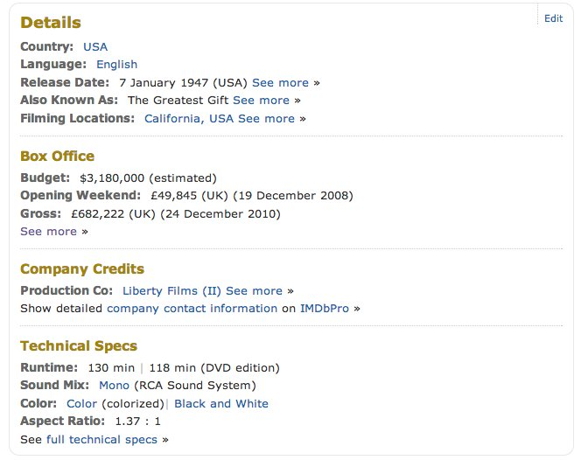
IMDb: Movie Data

Slide 17
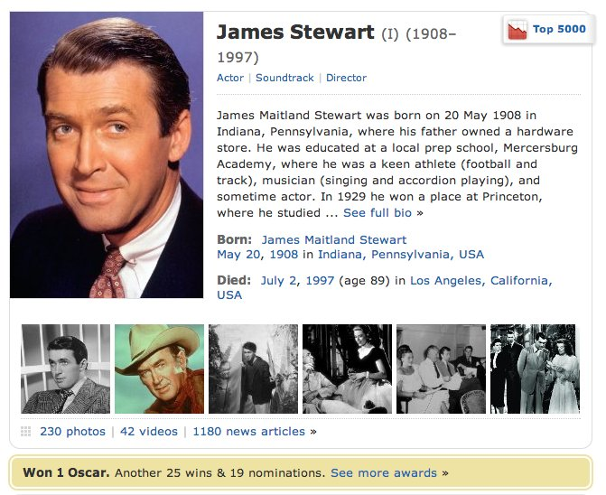
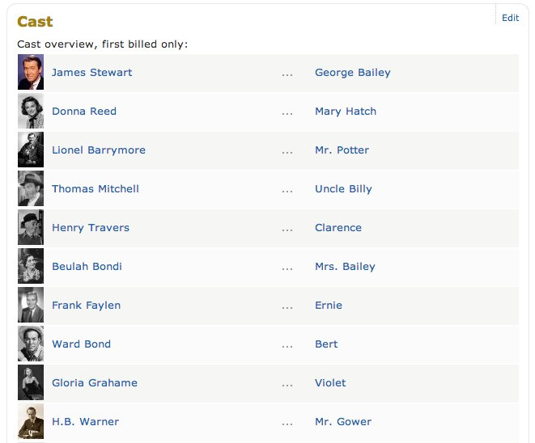
IMDb: Actor Data

Slide 18
Movie Questions
Can we predict how well people will like a movie? What about its gross?
What does the social network of actors look like? (Six degrees of Kevin Bacon)
What is the age distribution of actors and actresses in film?
Do stars live longer or shorter lives than the bit players or public?

Slide 19
Google Ngrams
Presents an annual time series of the frequency of every “popular” word/phrase with 1 to 5 words occurs in scanned books.
`Popular’ means appears >40 times in total.
Google has scanned about 15% of all books ever published, making this resource quite comprehensive.

Slide 20
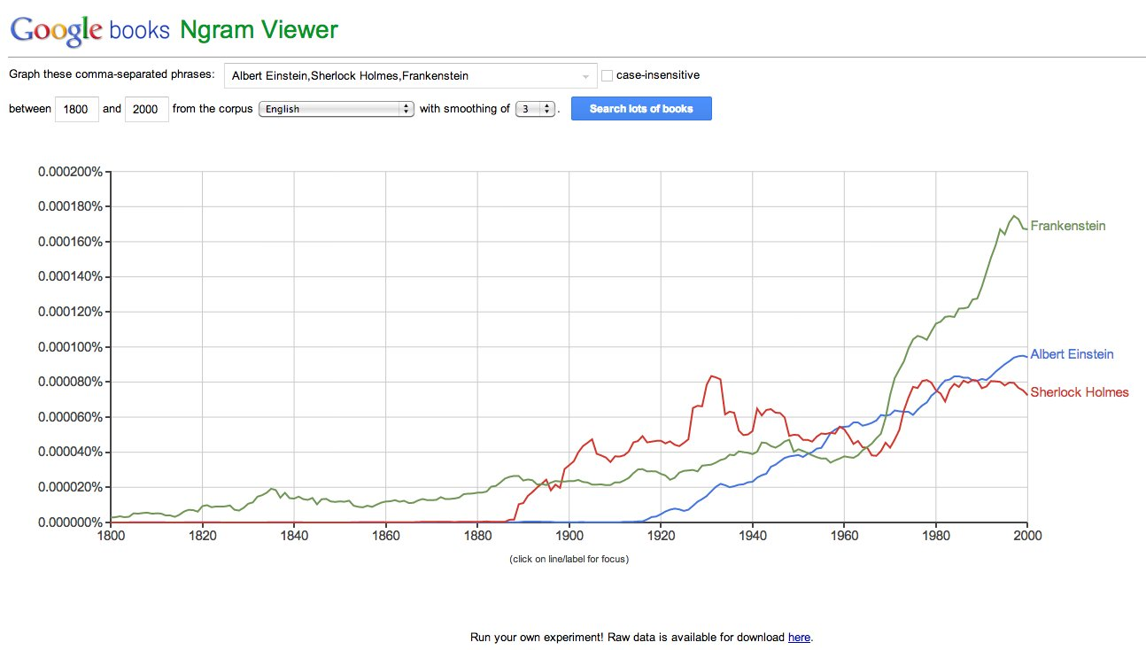
Google Ngram Viewer

Slide 21
Ngram Questions
How has the amount of cursing changed over time?
What is the lifespan of fame and technologies? Is it increasing/decreasing?
How often do new words emerge? Do they stay in common usage?
What words are associated with other words, i.e. can you build a language model?

Slide 22
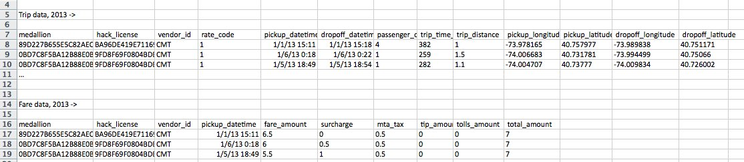
NYC Taxi Cab Data
Gives driver/owner, pickup/dropoff location, and fare data for every taxi trip taken.
Data obtained from NYC via Freedom of Information Act Request (FOA)

Slide 23
Taxicab Questions
How much do drivers make each night?
How far do they travel?
How much slower is traffic during rush hour?
Where are people traveling to/from at different times of the day?
Do faster drivers get tipped better?
Where should drivers go to pick up their next fare?

